Slide 1
Thermal Engineering II
P.V. Manu
Assistant Professor
Dept. of Mechanical Engineering
National Institute of Technology Calicut

Slide 2
Steam Nozzles
A steam nozzle may be defined as a passage of varying cross-section, through which heat energy of steam is converted to kinetic energy.
Its major function is to produce steam jet with high velocity to drive steam turbines.

Slide 3
Steam Nozzles
A turbine nozzle performs two functions:
(i.) It transforms a portion of energy o steam (obtained from steam generating unit) into kinetic energy.
(ii.) In the impulse turbine it directs the steam jet of high velocity against blades, which are free to move to convert kinetic energy into shaft work. In reaction turbines the nozzles which are free to move, discharge high velocity steam. The reactive force of the steam against the nozzle produces motion and work is obtained.

Slide 4
Steam Nozzles
The cross-section of a nozzle at first tapers to a smaller section (to allow for changes which occur due to changes in velocity, specific volume and dryness fraction as the steam expands); the smallest section being known as throat and then diverges to a large diameter.
The nozzle which converges to throat and diverges afterwards is known as convergent-divergent nozzle.
In convergent nozzle there is no divergence after the throat.
In a convergent-divergent nozzle, because of the higher expansion ratio, additional of divergent portion produces steam at higher velocities as compared to a convergent nozzle.

Slide 5
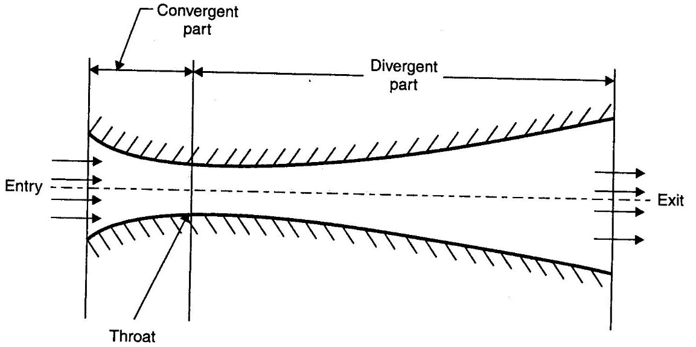
Steam Nozzles
Convergent-divergent nozzle

Slide 6
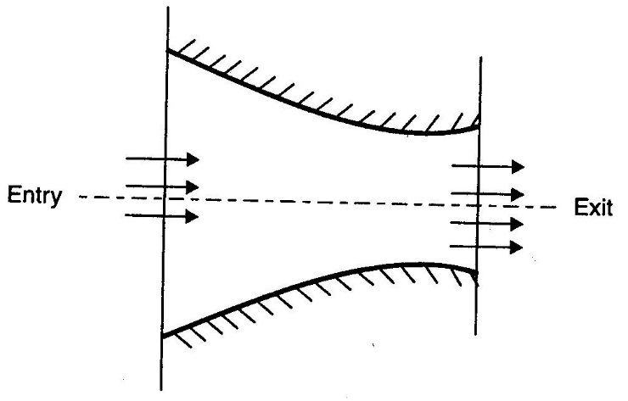
Steam Nozzles
Convergent nozzle

Slide 7
Steam flow through Nozzles
The steam flow through the nozzle may be assumed as adiabatic flow since during the expansion of steam in nozzle neither any heat is supplied nor rejected, work, however, is performed by increasing the kinetic energy of the steam.
As the steam passes through the nozzle, it loses its pressure as well as the heat.
The work done is equal to the adiabatic heat drop which in turn is equal to Rankine area.

Slide 8
Velocity of Steam
Steam enters the nozzle with high pressure and low initial velocity (it is so small as compared to the final velocity that is generally neglected) and leaves it with high velocity and low pressure.
This is due to the reason that heat energy of steam is converted into kinetic energy as it (steam) passes through the nozzle.
The final or outlet velocity of steam can be found as:
Let C = Velocity of steam at the section considered (m/sec)
h₁ = Enthalpy of steam entering the nozzle
h₂ = Enthalpy of steam at section considered
h_{d} = Heat drop during expansion of steam in the nozzle
= (h₁ – h₂)

Slide 9
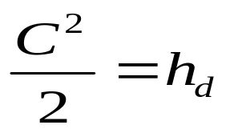
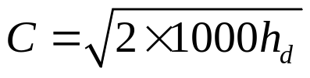
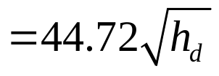
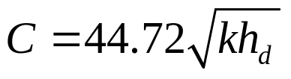
Velocity of Steam
Consider 1 kg of steam and flow to be frictionless adiabatic.
Gain in kinetic energy = Adiabatic heat drop
where h_{d} is in kJ
In practice, there is loss due to friction in the nozzle and its value varies from 10 to 15 percent of total heat drop. Due to this, total heat drop is minimized. Let heat drop after deducting friction loss be kh_{d}. The velocity,

Slide 10
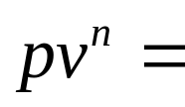
Discharge through the Nozzle and Conditions for its Maximum Value
Let p₁ = Initial pressure of steam,
v₁ = Initial volume of 1 kg of steam at pressure p₁ (m³)
p₂ = Steam pressure at the throat
v₂ = Volume of 1 kg of steam at pressure p₂ (m³)
A = Cross-sectional area of nozzle at throat (m²)
C = Velocity of steam (m/s)
The steam flowing through the nozzle follows approximately the equation given below:
Constant
Where, n = 1.135 for saturated steam & n = 1.3 for superheated steam. For wet steam, n can be obtained from Dr. Zenner equation.
ie, n = 1.035 + 0.1x, where x = initial dryness fraction of steam

Slide 11
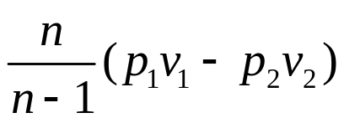
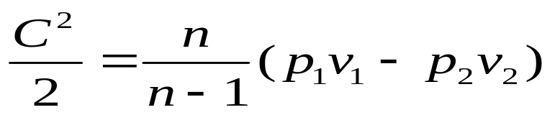
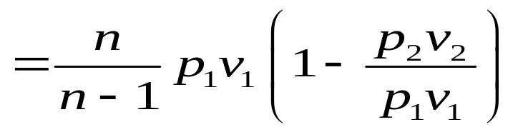
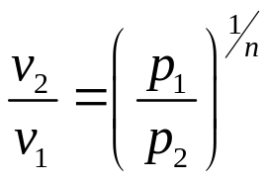
Discharge through the Nozzle and Conditions for its Maximum Value
Work done per kg of steam during the cycle (Rankine area)
=
Gain in kinetic energy = Adiabatic heat drop = Work done during Rankine cycle, or
Substituting in above equation and simplifying,

Slide 12
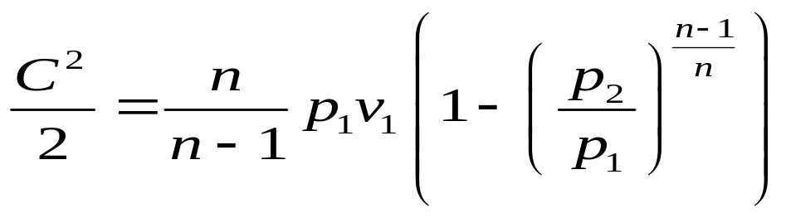
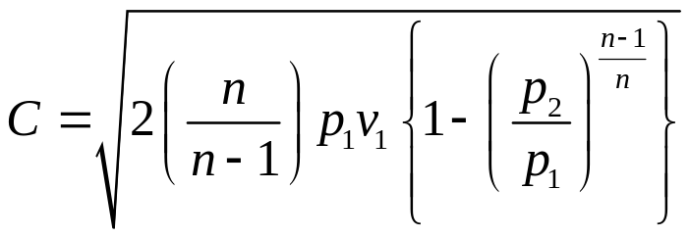
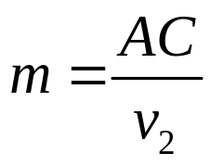
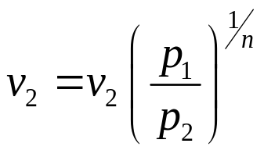
Discharge through the Nozzle and Conditions for its Maximum Value
If m is the mass of the steam discharged in kg/s, then
Substituting and velocity (C) in above equation,

Slide 13
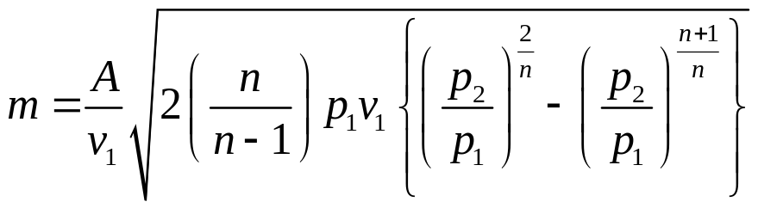
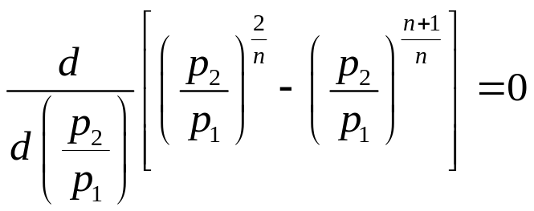
Discharge through the Nozzle and Conditions for its Maximum Value
From the above equation there is only one value of the ratio (called critical pressure ratio) p₂/p₁ which will produce the maximum discharge. This can be obtained by differentiating ‘m’ with respect to (p₂/p₁) and equating it to zero.
As other quantities except p₂/p₁ are constant

Slide 14
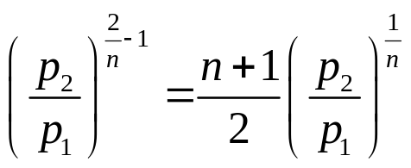
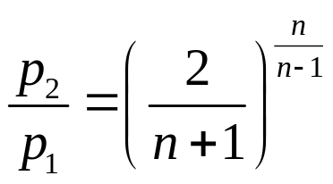


Discharge through the Nozzle and Conditions for its Maximum Value
Hence, the discharge through the nozzle will be maximum when critical pressure ratio,
i.e.,
For saturated steam, n=1.135,
For superheated steam, n=1.3,

Slide 15
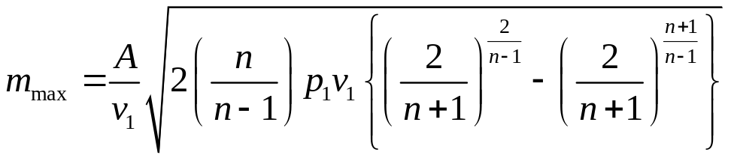
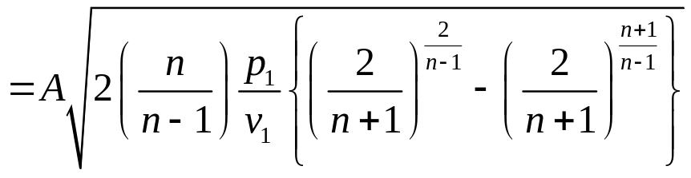
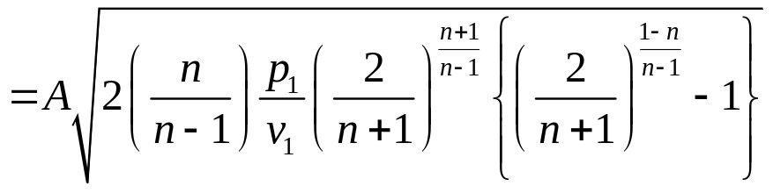
Discharge through the Nozzle and Conditions for its Maximum Value
Substituting the value of (p₂/p₁) in mass flow rate equation, we will get the maximum discharge as:

Slide 16
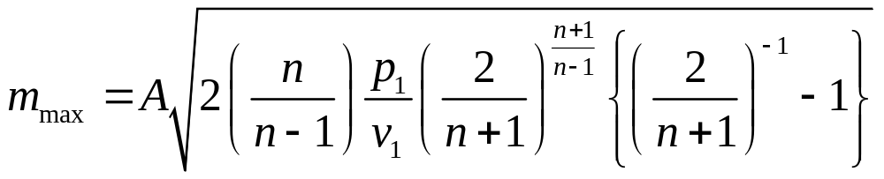
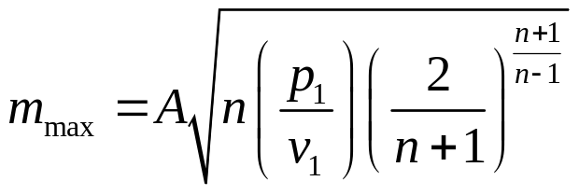
Discharge through the Nozzle and Conditions for its Maximum Value
From the above equation it is evident that the maximum mass flow depends only on the initial condition of the steam (p₁, v₁) and the throat area and is independent of the final pressure of steam i.e. at the exit of the nozzle.
The addition of the divergent part of the nozzle after the throat does not affect the discharge of steam but it only accelerates the steam leaving the nozzle.

Slide 17
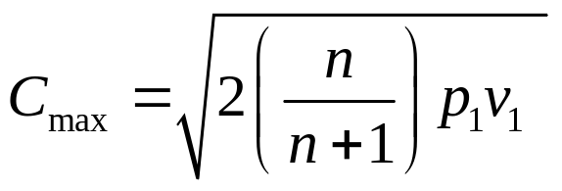
The discharge through the nozzle increases as the pressure at the throat of the nozzle (p₂) decreases, when the supply pressure (p₁) is constant.
But once the nozzle pressure (p₂) reaches the critical value, the discharge reaches a maximum and after that the throat pressure and mass flow remains constant irrespective of the pressure at the exit.
The velocity of steam at the throat of the nozzle when the discharge is maximum, is obtained by substituting the value of (p₂/p₁) in velocity equation.
Above equation indicates that the velocity is also dependent on initial conditions of the steam.

Slide 19
Nozzle Efficiency
When the steam flows through a nozzle, the final velocity of steam for a given pressure drop is reduced due to:
(i.) Friction between the nozzle surface and steam
(ii.) Inertia friction of steam itself
(iii.) Shock losses

Slide 20
Nozzle Efficiency
Most of these frictional losses occur between the throat and exit in convergent-divergent nozzle. These frictional losses entail the following effects:
(i.) The expansion is no more isentropic and enthalpy drop is reduced.
(ii.) The final dryness fraction of steam is increased as the kinetic energy gets converted into heat due to friction and is absorbed by steam.
(iii.) The specific volume of steam is increased as the steam becomes more dry due to the frictional reheating.

Slide 21
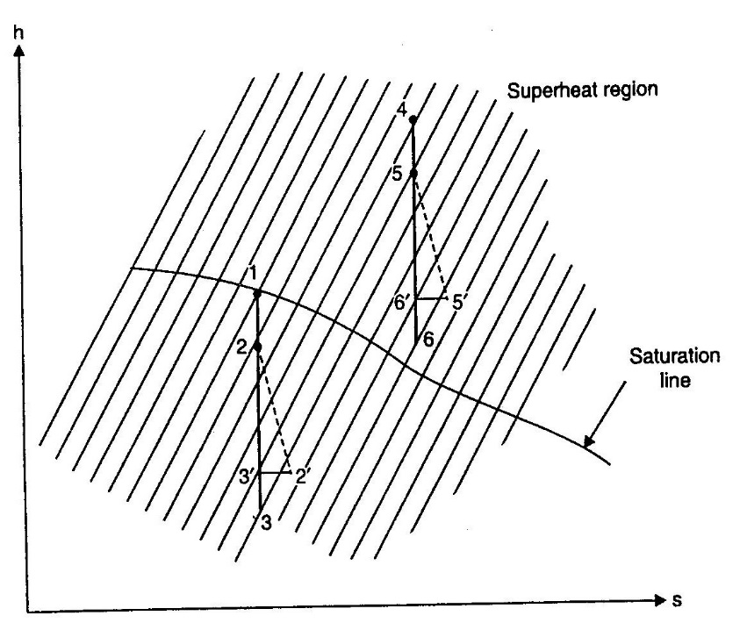
Nozzle Efficiency
Figure represents on Mollier diagram the effect of friction on steam flow through a nozzle.

Slide 22
Nozzle Efficiency
The point 1 represents the initial condition of steam which enters the nozzle in a dry saturated state.
If the friction is neglected, the expansion of steam from entry to throat is represented by the vertical line 1-2 and that from the throat to the exit by 2-3.
If the friction were taken into account the heat drop would have been somewhat less than 1-3. Let this heat drop be 1-3’. From 3’ draw a horizontal line which cuts the same pressure line on which point 3 lies, at the point 2’ which represents the final condition of steam.
It has to be noted that dryness fraction of steam is more at point 2’ than at point 3. Hence the effect of friction is to improve the quality of steam.

Slide 23
Nozzle Efficiency
The value of co-efficient (k) in the equation for the velocity of expanding steam is given by,
k = Actual heat drop/Isentropic heat drop
= (1 – 3’)/(1 – 3) = (h₁ – h_{3’})/(h₁ – h₃)
The actual expansion is represented by the curve 1-2-2’ since the friction occurs mainly between the throat and exit.
But, if the steam at the entry to nozzle were superheated corresponding to the point 4, the expansion can be represented by the vertical line 4-6, if friction were neglected and by 4-5-5’ if the friction were taken into account.

Slide 24
Nozzle Efficiency
In this case, k = (4 – 6’)/(4 – 6)
= (h₄ – h_{6’})/(h₄ – h₆)
The point 5’ represents the final condition of steam. It may be noted that the friction tends to superheat steam.
Therefore, it can be concluded that friction tends to decrease the velocity of steam and increase the final dryness fraction or superheat the steam.

Slide 25
Nozzle Efficiency
The nozzle efficiency is, therefore, defined as the ratio of the actual enthalpy drop to the isentropy enthalpy drop between the same pressures.
ie, Nozzle efficiency = h₁ – h_{3’}/h₁ – h₃ or
= h₄ – h_{6’}/h₄ – h₆ as the case may be.

Slide 26
Nozzle Efficiency
If the actual velocity at exit from the nozzle is C_{2’} and the velocity at exit when the flow is isentropic is C₃, then using the steady flow energy equation, in each case we have
h₁ + [C₁²/2] = h₃ + [C₃²/2] or h₁ – h₃ = [C₃² – C₁²]/2
and h₁ + [C₁²/2] = h_{2’} + [C_{2’}²/2] or h₁ – h_{2’} = [C_{2’}² – C₁²]/2
therefore, Nozzle efficiency = [C_{2’}² – C₁²]/ [C₃² – C₁²]
When the inlet velocity, C_{1’} is negligibly small then
Nozzle efficiency = C_{2’}² / C₃²

Slide 27
Nozzle Efficiency
Sometimes a velocity co-efficient is defined as the ratio of the actual exit velocity to the exit velocity when the flow is isentropic between the same pressures,
Velocity co-efficient = C_{2’} / C₃
It can be seen from the above equations that the velocity co-efficient is the square root of the nozzle efficiency, when the inlet velocity is assumed to be negligible.

Slide 28
Supersaturated/Metastable Expansion of Steam in a Nozzle
When steam flows through a nozzle, it would normally be expected that the discharge of steam through the nozzle would be slightly less than the theoretical value.
But it has been observed during experiments on flow of wet steam that the discharge is slightly greater than that calculated by the formula.
This is because the converging part of the nozzle is so short and the steam velocity so high that the molecules of steam have insufficient time to collect and form droplets so that normal condensation does not take place. Such rapid expansion is said to be metastable and produces a supersaturated state.

Slide 29
Supersaturated/Metastable Expansion of Steam in a Nozzle
In this state of supersaturation the steam is undercooled to a temperature less than that corresponding to its pressure, consequently the density of steam increases and hence the weight of discharge.
Prof. Wilson through experiments showed that dry saturated steam, when suddenly expanded in the absence of dust, does not condense until its density is about 8 times that of the saturated vapour of the same pressure.

Slide 30
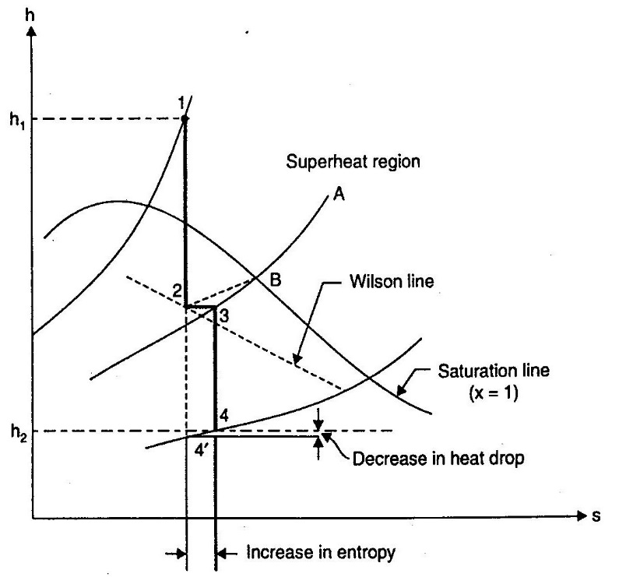
Supersaturated/Metastable Expansion of Steam in a Nozzle
Supersaturated flow of steam

Slide 31
Problems: Steam Nozzles
1.) Dry saturated steam at a pressure of 11 bar enters a convergent-divergent nozzle and leaves at a pressure of 2 bar. If the flow is adiabatic and frictionless, determine (a) the exit velocity of steam (b) ratio of cross section at exit and that at throat. Assume the index of adiabatic expansion to be 1.135.

Slide 32
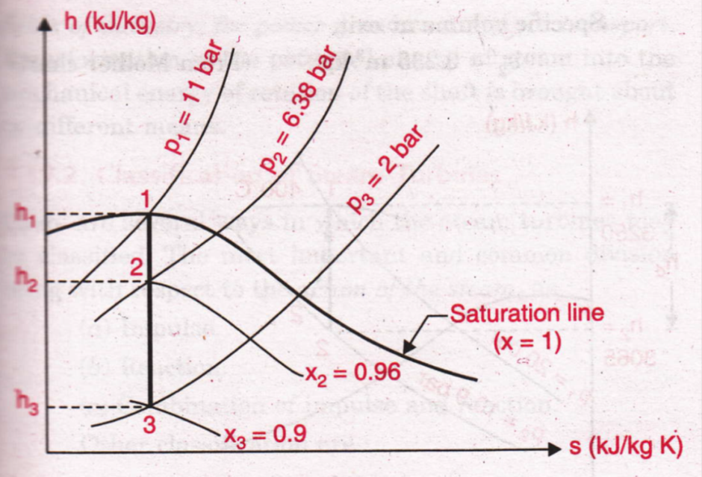
Problems: Steam Nozzles
Sol. 1.) p₁ = 11 bar, p₃ = 2 bar, p₂ = throat pressure, n = 1.135
Mollier Chart

Slide 33

Problems: Steam Nozzles
Sol. 1.)
= [2/(1.135 + 1)] ^{1.135/(1.135 – 1)} = 0.58
p₂ = 0.58 p₁ = 6.38 bar
From Mollier chart, point 1 is located on the dry saturation line corresponding to 11 bar pressure.
From point 1, draw a vertical line 1-3 cutting the pressure line 2 bar.
Point 2 corresponding to throat pressure 6.38 bar is located on the vertical line.
Adiabatic heat drop between the inlet and throat,
h_{d} = h₁ – h₂ = 2780 – 2679 = 101 kJ/kg

Slide 34
Problems: Steam Nozzles
Sol. 1.) x₂ = 0.96, v_{g2} = 0.297 m³/kg
Throat velocity, C₂ = 44.72 √h_{d} = 44.72 √101 = 449.4 m/s
Mass flow rate in kg/s, m = (A₂ . C₂)/v₂ = (A₂ . C₂)/(x₂ . v_{g2})
Throat area, A₂ = (m x₂ v_{g2})/C₂ = 0.000634 m
From Mollier chart, x₃ = 0.9
From steam tables, v_{g3} = 0.885 m³/kg (at 2 bar)
Adiabatic heat drop between inlet and exit, h_{d’} = h₁ – h₃
= 2780 – 2480 = 300 kJ/kg
Exit velocity, C₃ = 44.72 √h_{d’} = 44.72 √300 = 774.6 m/s
Exit area, A₃ = (m x₃ v_{g3})/C₃ = 0.001028 m
Ratio of exit area/throat area = 0.001028 m/0.000638 m
= 1.62

Slide 35
Problems: Steam Nozzles
2.) The nozzles of a De laval steam turbine are supplied with dry saturated steam at a pressure of 9 bar. The pressure at the outlet is 1 bar. The turbine has two nozzles with a throat diameter of 2.5 mm. Assuming nozzle efficiency as 90% and that of turbine rotor 35%, find the quality of steam used per hour and the power developed.

Slide 36
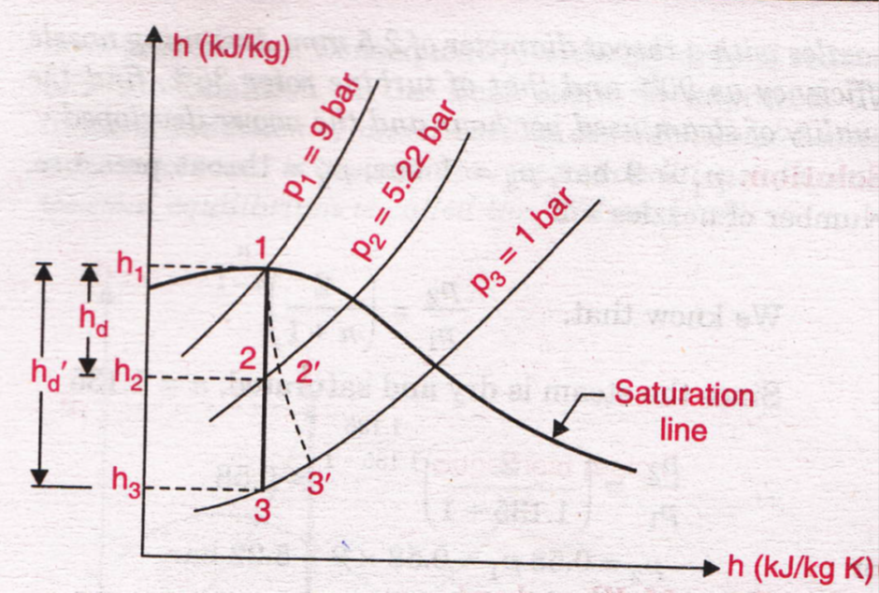
Problems: Steam Nozzles
Sol. 2.)

